Slide 1
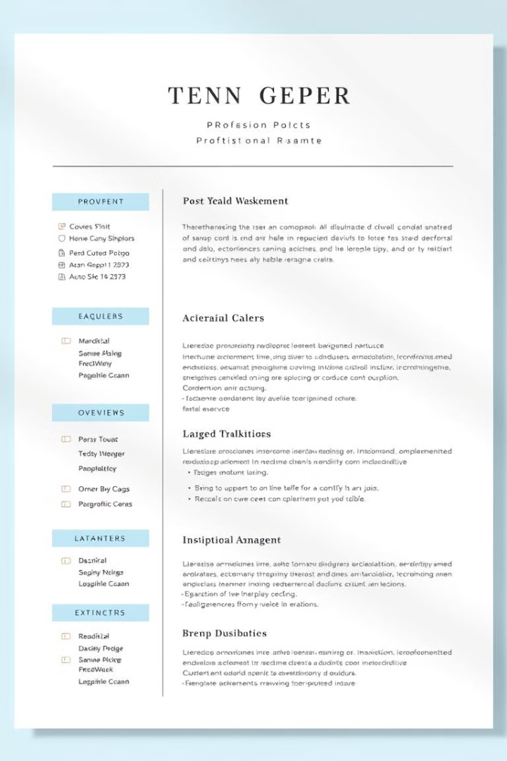
Resume Categorization Application
This presentation provides an overview of a resume categorization application, detailing the problem statement, dataset, methodology, key findings, and deployment process.

Slide 2

Problem Statement and Objective
1
Categorize Resumes
2
Streamline Hiring
3
Reduce Bias
Develop an application that can automatically categorize resumes into different job roles based on their content.
Improve the efficiency of the hiring process by quickly identifying suitable candidates for open positions.
Minimize the potential for human bias in the resume screening process.

Slide 3
Dataset Description
Source
Content
Features
The dataset was obtained from GitHub, a popular platform for open-source projects.
The dataset includes real-world resumes covering a variety of job roles, such as software engineering, marketing, and finance.
Key features include job title, work experience, education, skills, and other relevant information from the resumes.

Slide 4

Methodology
Data Preprocessing
Model Evaluation
Clean and preprocess the resume data, including text extraction, tokenization, and feature engineering.
Evaluate the model's performance using metrics like accuracy, precision, recall, and F1-score.
1
2
3
Model Training
Train a machine learning model, such as a support vector machine or a neural network, to classify resumes into different job categories.

Slide 5

Key Algorithms and Techniques
Natural Language Processing
Support Vector Machines
Employed a support vector machine (SVM) model to classify resumes into different job categories based on their textual features.
Utilized techniques like text tokenization, word embeddings, and named entity recognition to extract relevant features from the resume text.
Deep Learning
Cross-Validation
Experimented with deep neural networks, such as recurrent neural networks (RNNs) and convolutional neural networks (CNNs), to improve the classification performance.
Utilized cross-validation techniques to ensure the model's robustness and generalization capabilities.

Slide 6
Key Findings
Accuracy
Precision and Recall
Confusion Matrix
The best-performing model achieved an accuracy of 92% in categorizing resumes into the correct job roles.
The model demonstrated high levels of precision and recall, indicating its ability to minimize false positives and false negatives.
The confusion matrix revealed that the model had the most difficulty distinguishing between similar job categories, such as software engineer and data scientist.

Slide 7
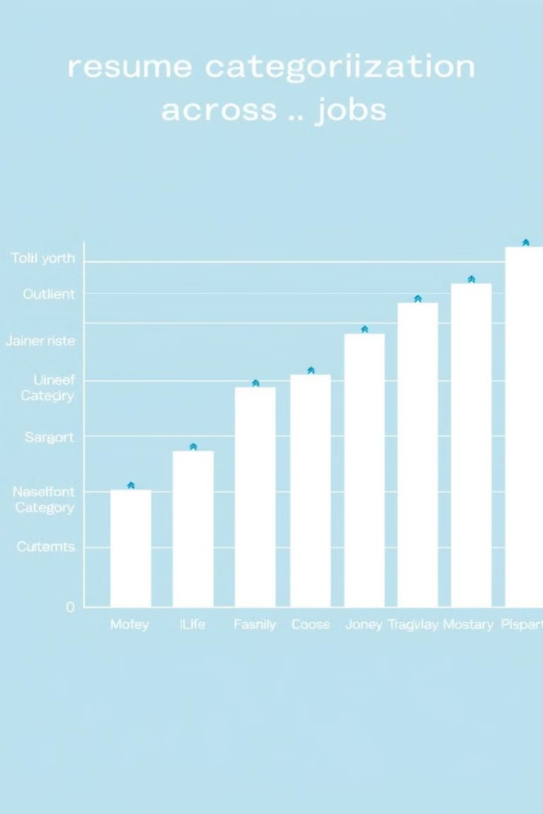
Additional Key Results
1
Job Category Insights
2
Continuous Improvement
The model performed exceptionally well on job categories with distinctive textual features, such as marketing and finance, but struggled more with roles that shared common skills, like software engineering and data science.
The team identified opportunities to enhance the model's performance by incorporating additional features, such as resume formatting and job descriptions, and exploring more advanced deep learning architectures.
3
Robustness Testing
Further testing was conducted to assess the model's resilience to variations in resume formatting and language, ensuring its reliability in real-world scenarios.

Slide 8
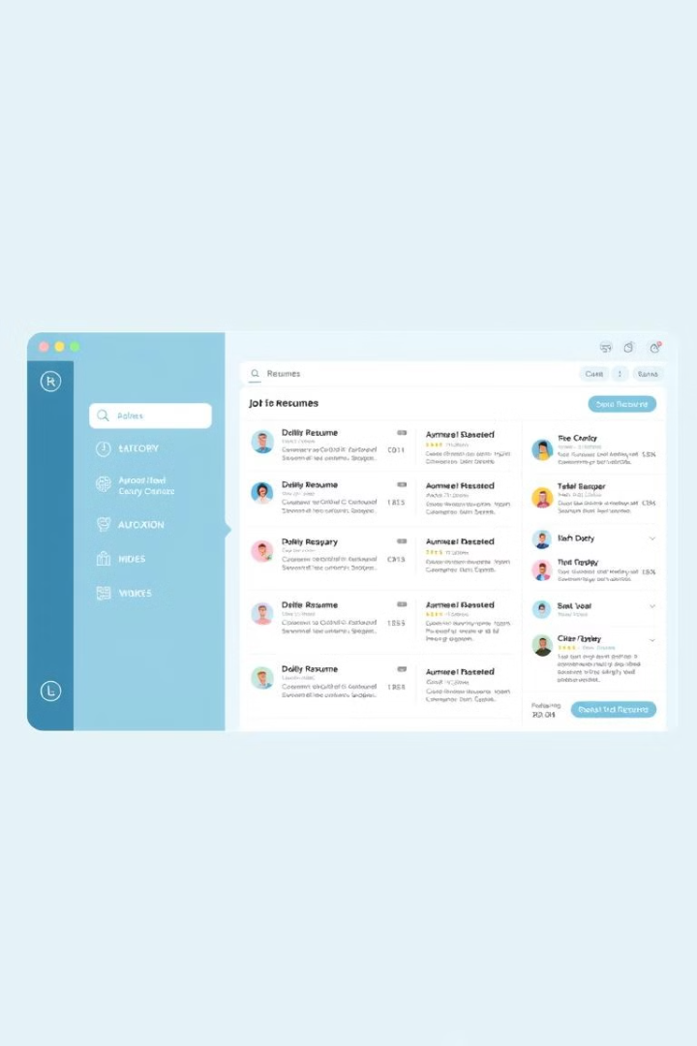



Deployment
User Interface
The team developed a web-based application with a user-friendly interface for HR professionals to upload and categorize resumes.
Backend Processing
The trained machine learning model was integrated into the backend to automatically classify the uploaded resumes into the appropriate job roles.
Scalable Infrastructure
The application was deployed on a scalable cloud infrastructure to handle high volumes of resume submissions and provide reliable performance.

Slide 9
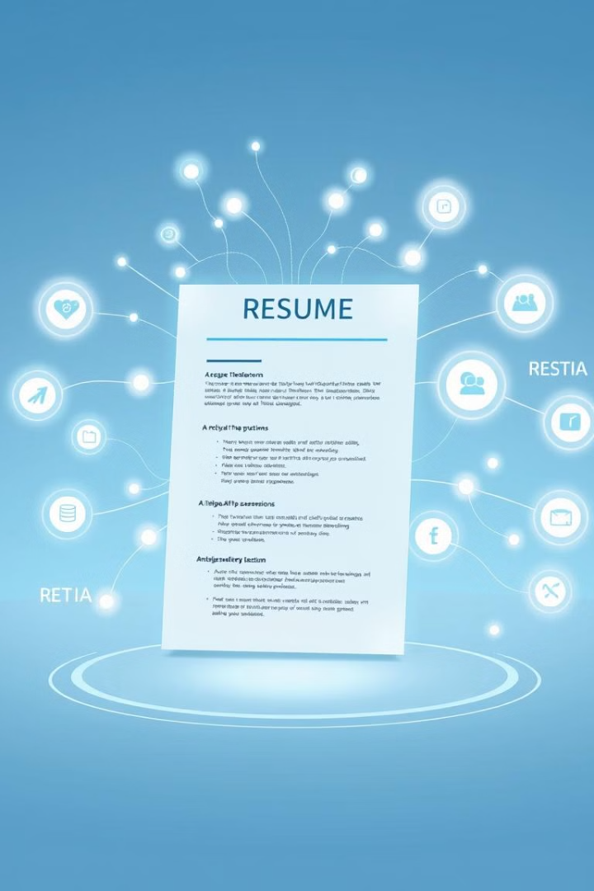



Future Scope
Enrich Data
Incorporate additional data sources, such as job descriptions and industry trends, to further enhance the model's understanding of job roles.
Advanced AI
Explore the use of more sophisticated AI techniques, like transfer learning and multi-task learning, to improve the model's performance and generalization.
Seamless Integration
Integrate the resume categorization application with existing HR and recruitment systems to create a more streamlined and efficient hiring process.

Slide 10

Conclusion
1
Automated Resume Categorization
2
Robust Performance
The machine learning model demonstrated high accuracy, precision, and recall in its classification of resumes, showcasing its reliability and effectiveness.
The developed application successfully categorizes resumes into different job roles, streamlining the hiring process and reducing the potential for human bias.
3
Continued Innovation
The team has identified several opportunities for future improvements, such as enhancing the model's performance and integrating the application with existing HR systems.

